Slide 1

3160 Database Project
Aaron Harabedian

Slide 2
Project Goals
Extend CraveOnCampus database
Add Driver rating system
Add Restaurant rating system
Extend existing database
Create ERD, Use Diagram, Business Rules, and Data Dictionary
Demonstrate an understanding of SQL

Slide 3
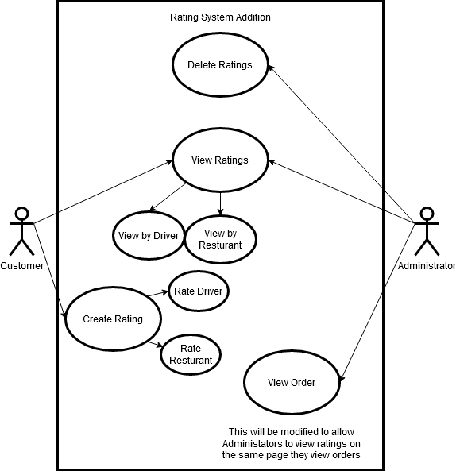
Use Case Diagram

Slide 4
Business Rules
Customers can leave ratings for every order.
Every rating will allow a driver rating and a restaurant rating and a comment.
Customers can view the ratings for a driver and restaurant.
Administrators can view ratings by order.
Only one rating can be attached to one order.
The ratings will be out of five
Administrators can view and delete ratings.

Slide 5
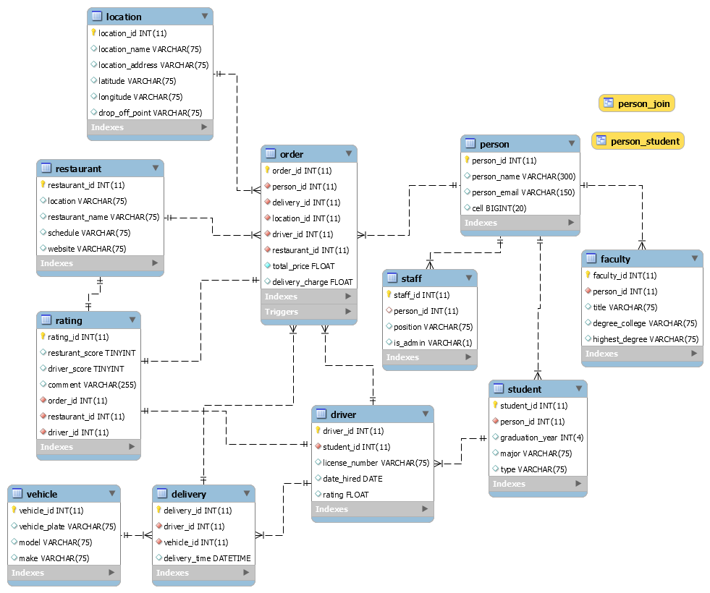
ERD

Slide 6
Stored Procedures
Calculate Restaurant Ratings
Calculate Driver Ratings
Add Rating

Slide 7
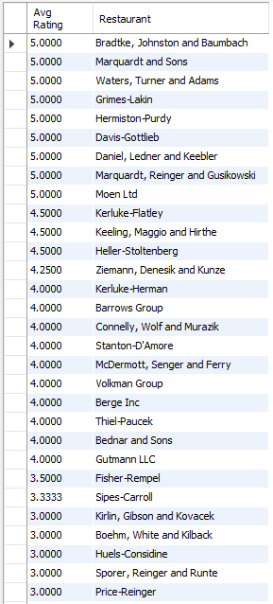
Calculate Restaurant Ratings

Slide 8
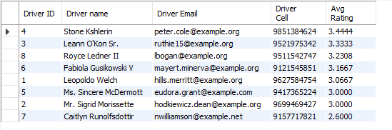
Calculate Driver Ratings

Slide 9
Add Rating

Slide 10
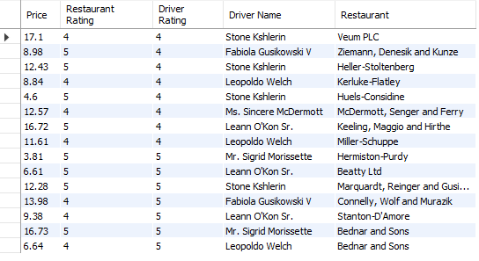
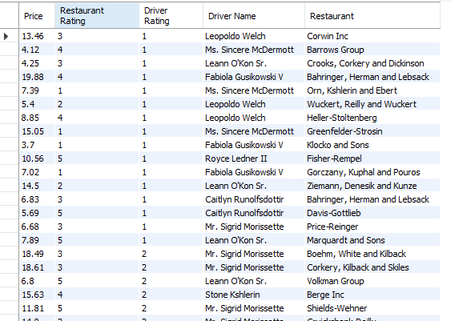
Custom Views
Good Orders
Bad Orders

Slide 11
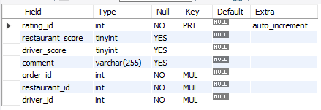
Explain Ratings Table
Foreign keys for optimized data storage.
Allows for complex relationships
Allows for ratings to exist without drivers, orders, or restaurants
Allows for simple use.

